Slide 1
Flight data analysis
Engineering big-data systems
Divyansh Srivastava Course Instructor: Yusuf Ozbek

Slide 2
Data
I have used Flight delay prediction dataset from ASA Sections on Statistical Computing Statistical Graphics
http://stat-computing.org/dataexpo/2009/
Data Introduction
The data consists of flight arrival and departure details for all commercial flights within the USA, from October 1987 to April 2008. This is a large dataset: there are nearly 120 million records in total, and takes up 1.6 gigabytes of space compressed and 12 gigabytes when uncompressed.

Slide 3
 | Name | Description
1 | Year | 1987-2008
2 | Month | 1-12
3 | DayofMonth | 1-31
4 | DayOfWeek | 1 (Monday) - 7 (Sunday)
5 | DepTime | actual departure time (local, hhmm)
6 | CRSDepTime | scheduled departure time (local, hhmm)
7 | ArrTime | actual arrival time (local, hhmm)
8 | CRSArrTime | scheduled arrival time (local, hhmm)
9 | UniqueCarrier | unique carrier code
10 | FlightNum | flight number
11 | TailNum | plane tail number
12 | ActualElapsedTime | in minutes
13 | CRSElapsedTime | in minutes

Slide 4
14 | AirTime | in minutes
15 | ArrDelay | arrival delay, in minutes
16 | DepDelay | departure delay, in minutes
17 | Origin | origin IATA airport code
18 | Dest | destination IATA airport code
19 | Distance | in miles
20 | TaxiIn | taxi in time, in minutes
21 | TaxiOut | taxi out time in minutes
22 | Cancelled | was the flight cancelled?
23 | CancellationCode | reason for cancellation (A = carrier, B = weather, C = NAS, D = security)
24 | Diverted | 1 = yes, 0 = no
25 | CarrierDelay | in minutes
26 | WeatherDelay | in minutes
27 | NASDelay | in minutes
28 | SecurityDelay | in minutes
29 | LateAircraftDelay | in minutes

Slide 5
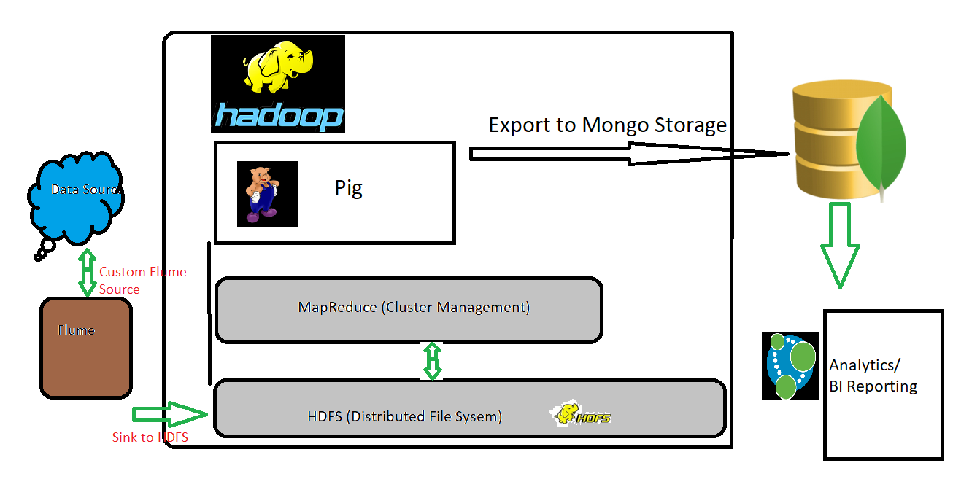
Hadoop Ecosystem & Project Flow

Slide 6
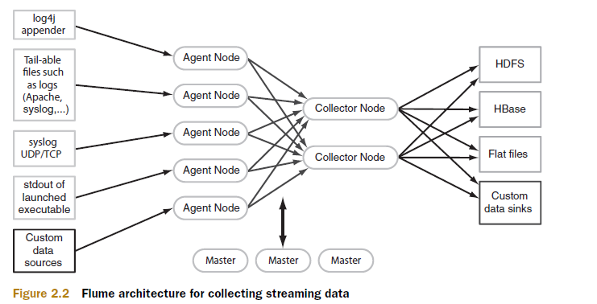
Data Ingestion
Using Flume
Apache Flume is a distributed, reliable, and available service for efficiently collecting, aggregating, and moving large amounts of streaming data into the Hadoop Distributed File System (HDFS).

Slide 7
Map-reduce using Hadoop
Monthly Average Flight Delay
Weekly Average Flight Delay
Flight delays between different cities and airlines
Slowest departure airport and airline
[Other analysis are based on the output of above MR jobs]

Slide 8
HDFS to NoSQL using Pig script
/* MongoDB libraries */
REGISTER /home/divyansh/pig-0.17.0/lib/mongo-java-driver-3.5.0.jar
REGISTER /home/divyansh/pig-0.17.0/lib/mongo-hadoop-pig-2.0.2.jar
REGISTER /home/divyansh/pig-0.17.0/lib/mongo-hadoop-core-2.0.2.jar
REGISTER /home/divyansh/pig-0.17.0/lib/mongo-hadoop-2.0.2.jar
Loading outputs from HDFS to Pig
And stored to MongoStorage

Slide 9
Flow after jobs
HDFS
Pig
MongoDB
Node Restful API
To BI Reporting
Graph DB

Slide 10
Generating reports using Power BI
Data can be exported from MongoDB to csv which is ingested to BI reporting tools as Power BI
Here is the link for BI reports
https://app.powerbi.com/view?r=eyJrIjoiY2ExYWZmYjAtNjYxYS00ZThlLTlmZDItYjc2ODhkMmU1YjU1IiwidCI6IjZhYmZjNzNmLWRhNjQtNDEzNy05ZjlmLTE1ZmFhZTU2ZjY4NSIsImMiOjN9

Slide 11
Graph database analysis
Neo4j is one of the powerful graph database.
We have cities as Nodes and flights as relationship.
You can find screenshots in next page

Slide 12
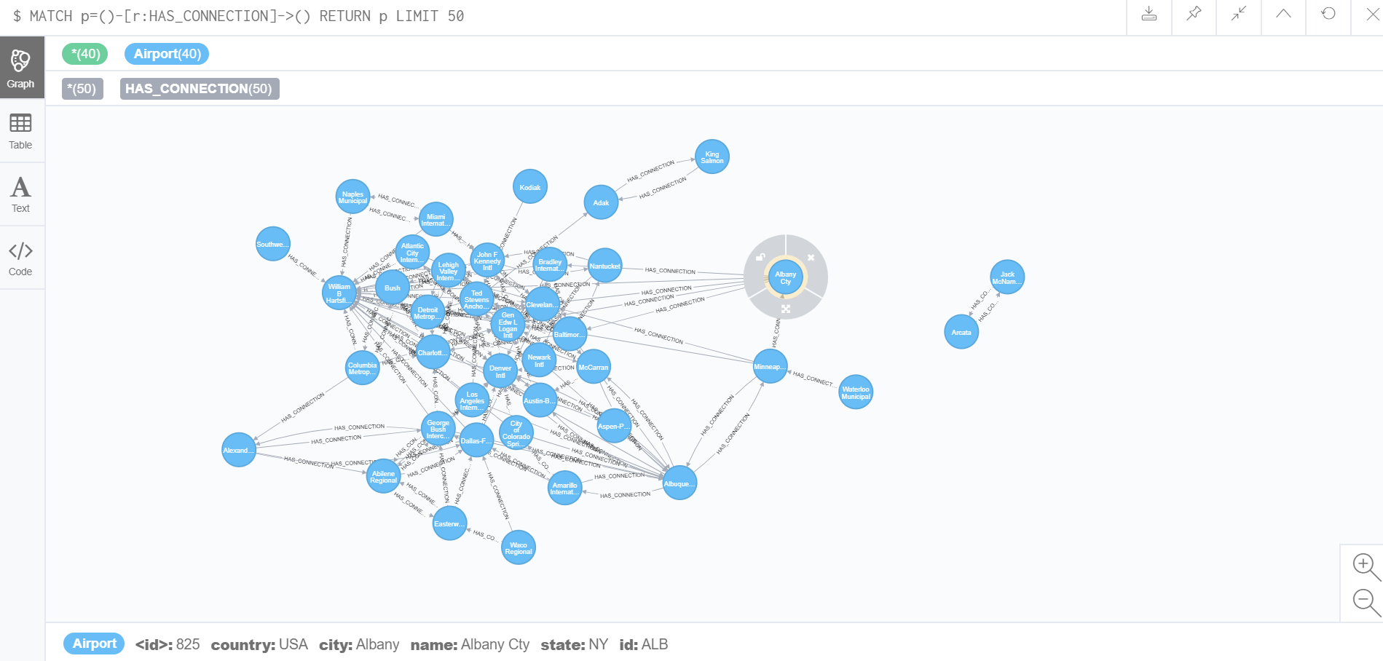

Slide 13
